Slide 1

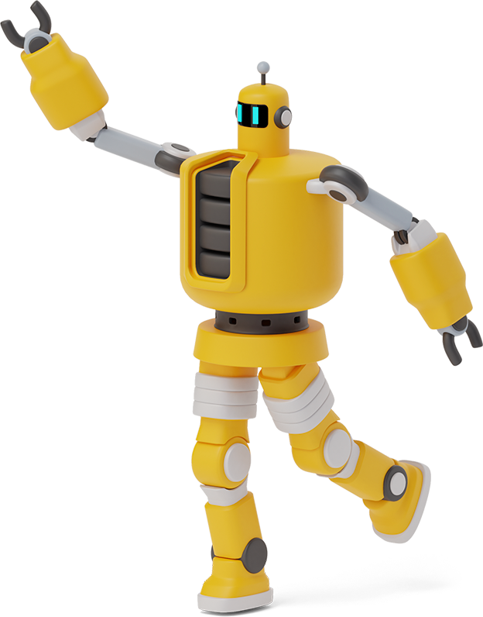
REAL-TIME HUMAN DETECTION AND COUNTING

Slide 2
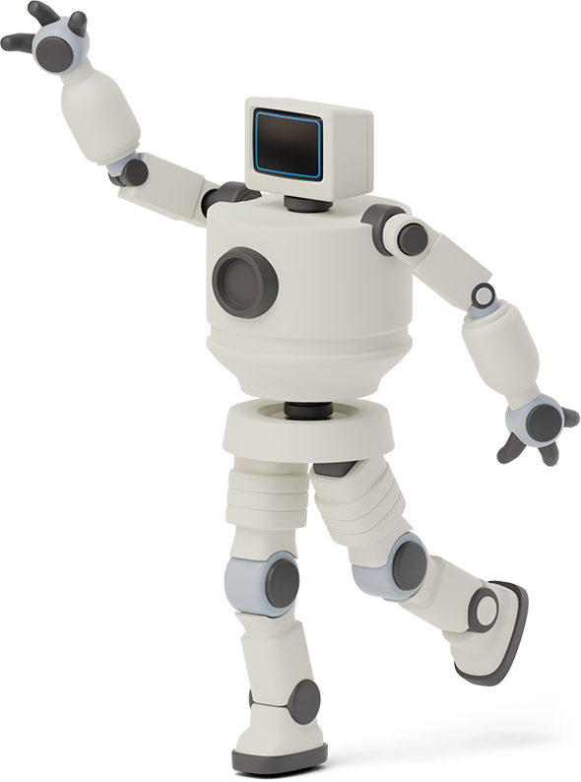

Team Members
- Harshit Mishra (19BCE0799)
- Alokam Nikhitha (19BCE2555)

Slide 3


Applications
1
Applications of Human Detection.

Slide 4
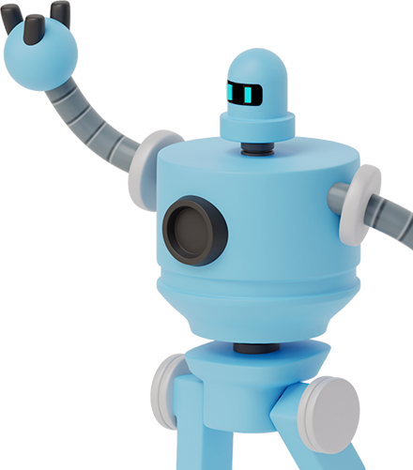
“The use of Human Detection range from personal security to automated vehicle systems. It is used in applications like self-driving cars, face detection, Action Recognition, Object Counting, etc…”

Slide 5
Challenges
2
Challenges in Performing Real-Time Human Detection.

Slide 6
Challenges
Environment Sensing Difficulty.
Gradient Variation Study
Video Redundancy
1
3
5
2
4
Similar boundary of Objects
High Computational Complexity

Slide 7
Methodology
3
Models and Technologies Employed in our Project.

Slide 8

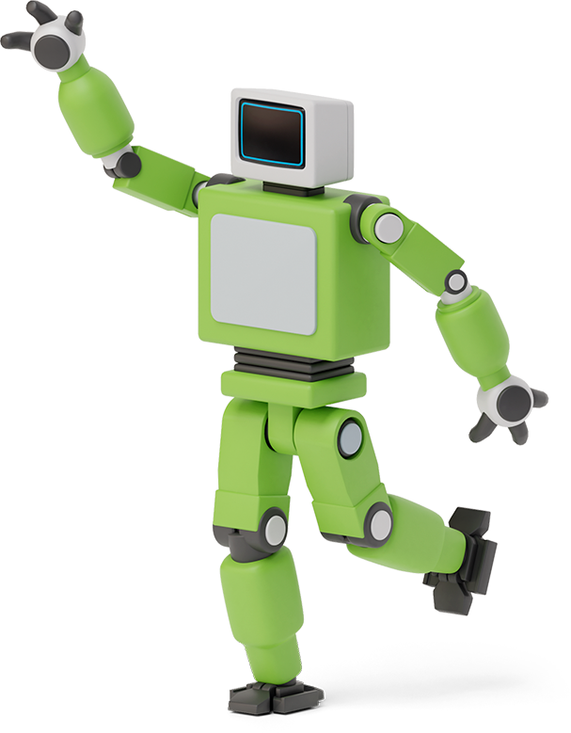

Methodology
We have employed Histogram of Oriented Gradient (HOG) as a feature descriptor in Computer Vision and Image Processing purpose.
The essential thought behind it is that local object appearance and shape within an image can be described by distribution of intensity gradients and edge directions.

Slide 9

Implementations
Heading on to Visual Studio Code

Slide 10
Results
Final Output of our Model

Slide 11
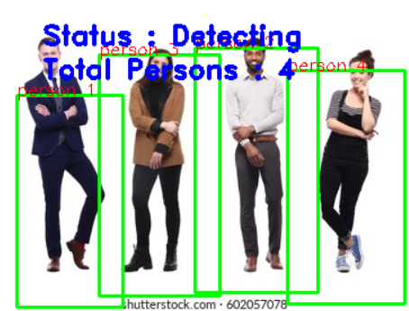
Input Image 1
Here we can see that there are 4 people in our image frame and the total person count is also 4 along with object boundary of each person.

Slide 12
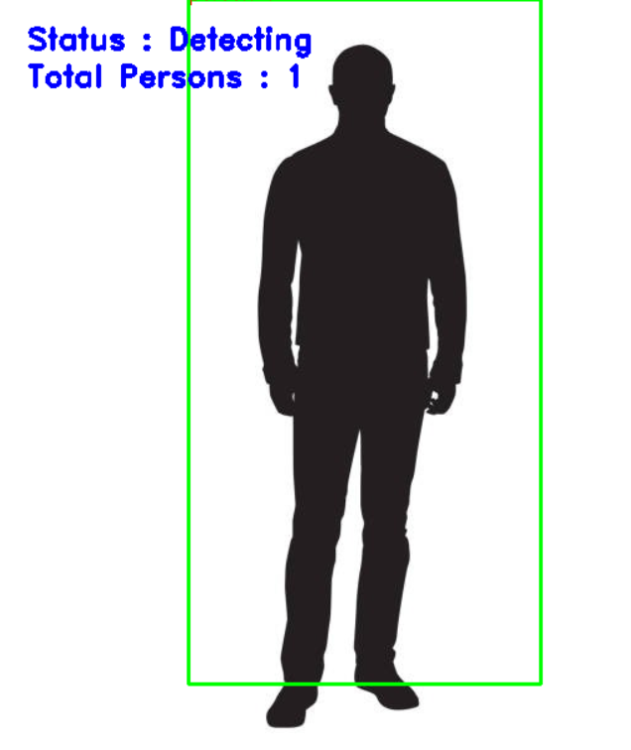
Input Image 2
Here we can see that there is not person but a person like boundary and since we are employing HOG, we still count the number of person to 1.

Slide 13
Thanks!
Thanks
Harshit Mishra
Alokam Nikhitha

